Slide 1
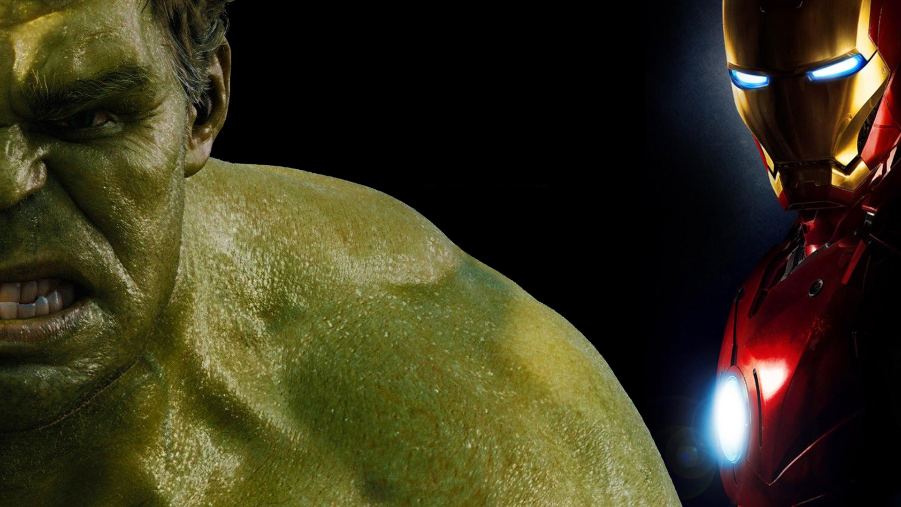
Iron man the clone attack
Kenny Rafael perroni molleton
REnATO LUIZ CARNEIRO JUNIOR

Slide 2
Story
Experiment with Bruce Banner
Basement
Sabotage
Army of Hulks

Slide 3
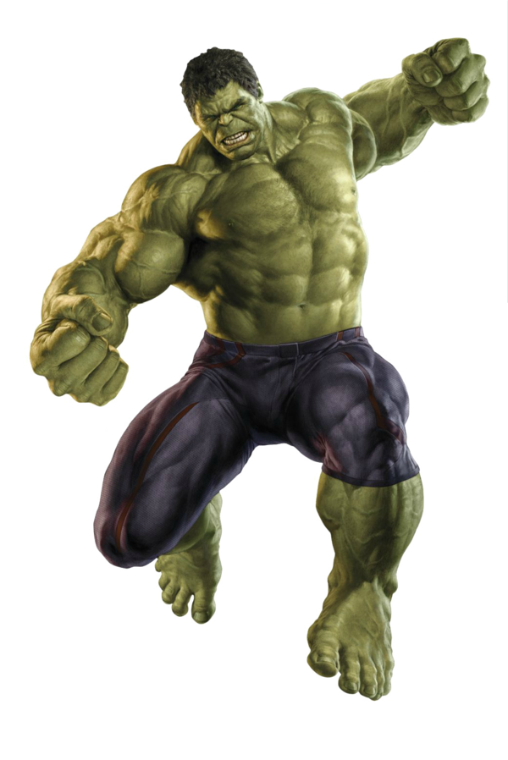
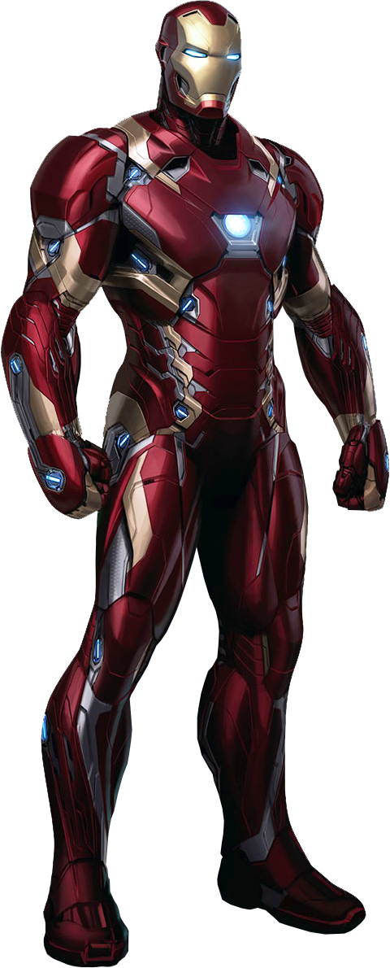
Characters

Slide 4
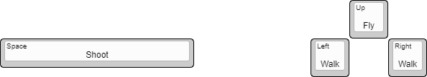
controls

